Slide 1
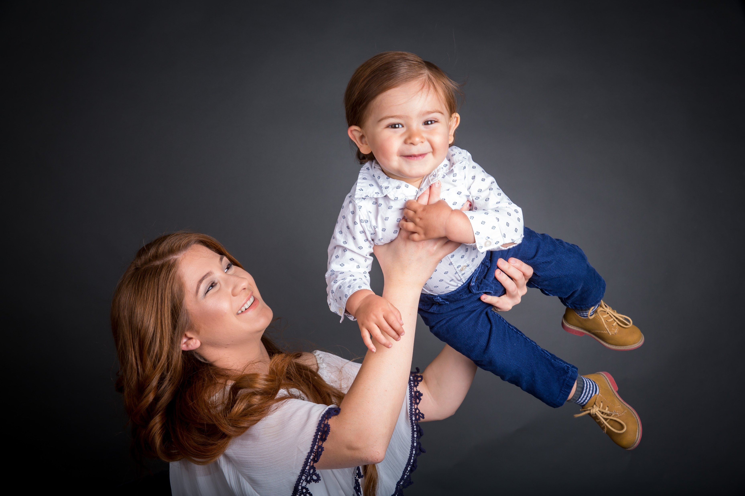
COMMUNITY ADVISORY BOARD 101

Slide 2
OBJECTIVES
Define Community Advisory Boards (CAB)
Talk about CABs within the NFP model
What are some elements for success

Slide 3
COMMUNITY ADVISORY BOARDS
Model Element #18: Community Support for NFP
“The implementing agency convenes a long-term community advisory board that meets at least quarterly to provide a community support system to the NFP program and ensure program quality and sustainability.”
Community support is necessary for program sustainability.
Notes:
Why is this model element important? Research shows there is a direct correlation between the quality of the process of building community collaboration and client retention. This is the “transfer of commitment” – when the community supports the program, this commitment can be operationalized.

Slide 4
TRANSFER OF COMMITMENT: WHAT DOES THIS LOOK LIKE?
Community
Stakeholders with a commitment to collaborating to implement NFP come together.
There is a “community coalition” supporting NFP.
Coalition
There is regular, proactive communication amongst coalition members and NSO.
CAB
Broad-based community support is fostered to support the agency that implements NFP.
A community advisory board is formed.
Notes:
The transfer of commitment starts with the engaged, visionary stakeholders who form a community coalition. These individuals are proactively in communication with the NSO PDer throughout the implementation planning process. The coalition is shepherding the planning this process. As the coalition strengthens, their role changes. They transition from a coalition to a community advisory board – a broad-based group of advocates who are prepared to help the program succeed. This commitment is passed from the CAB to the program administrator to the nurse home visitor and eventually to the program participant (“client”).

Slide 5
TOP 5 REASONS FOR BUILDING STRONG COMMUNITY PARTNERSHIPS FOR NFP:
To facilitate awareness and ongoing support for the program.
To generate and sustain a steady flow of referrals.
To foster linkages to additional services for clients.
To gain knowledge of community services and relationships.
To support clients through identification of “in kind” donations.

Slide 6
LET’S BRAINSTORM!
Notes:
What is your experience in building strong community partnerships – for NFP or for other programs that you run? What is easy to do in creating partnerships? What is hard? What would you like to keep doing? What would you like to stop doing? What is one new thing you’d like to do to foster community partnerships?

Slide 7
PURPOSE OF THE NURSE-FAMILY PARTNERSHIP CAB
Meet the needs identified by the local NFP implementing agency and support the program in an advisory capacity to achieve the program mission
This is a broad definition. What does this mean to you?
Notes:
Presenter states the purpose of the CAB. To the participants, “Because this is a broad definition, what does this mean to you?” Participants are asked to turn to their neighbor to articulate what this purpose means to them. Each participant is given 2 minutes to reflect.

Slide 8
WHAT DOES YOUR COMMUNITY ADVISORY BOARD DO?
A Community Advisory Board may:
Act as a creative sounding board
Provide moral support for decision-making
Is a conduit for community input and information-sharing
Advocates and educates to increase program awareness
Supports implementing agency staff as they identify funding and material resources
Generates unidentified referral sources
Leverages in-kind resources from the larger community
You are Community Ambassadors for NFP!
Notes:
So, what does the CAB actually do? What are its functions?

Slide 9
WHAT KINDS OF ACTIVITIES WILL THE CAB DO?
Client & Implementation Support:
Strengthen referral networks
Foster mother-to-mother peer support
Advocacy:
Establish/nurture relationships with state/local elected officials
Train CAB members to speak on behalf of the program (“Speakers’ Bureau”) to community groups, agencies, clubs, etc.
Development:
Cultivate your team of influencers
Target funders to approach to tell your story and seek support
Notes:
At this point, some of you may need some more specific examples and may be wondering what kinds of activities the CABs might organize. These are just some examples for you to consider in the areas of Advocacy, Client Support and Development. There may be other areas that you have considered. Presenter reviews the list. Presenter asks, “How do you build public awareness for NFP?” Hand out “goal-setting priorities” spreadsheet.

Slide 10
WHAT IS YOUR VISION/MISSION FOR THE CAB?
Your mission statement may be:
The CAB is committed to improving the socio-economic and health status of residents in [insert County] through the creation of strong, self-sufficient family units.
Your vision statement may be:
The vision of the CAB is to successfully support the [insert County] NFP program through providing leadership, community involvement and maximizing available funding.
Notes:
Presenter offers example mission and vision statements. Presenter asks for feedback/reactions to the mission and vision statements. Do your CABs have mission and vision statements like these? Are they useful? Why?

Slide 11
LET’S BRAINSTORM!
Notes:
What is your experience in building strong community partnerships – for NFP or for other programs that you run? What is easy to do in creating partnerships? What is hard? What would you like to keep doing? What would you like to stop doing? What is one new thing you’d like to do to foster community partnerships?

Slide 12
WHAT TO LOOK FOR IN POTENTIAL CAB MEMBERS?
Experienced and successful individual who works well collaboratively
Has motivation and interests in the NFP program
Excellent communication skills/ability to influence others
A personal philosophy that supports NFP model
Knowledge of and access to resources
Has time to commit to the CAB
Notes:
These next slides focus on who should serve on a Community Advisory Board and some factors that you might consider when building or reorganizing your CAB. Presenter lists the qualities or factors to be considered when seeking a CAB member – Does the person have a passion about children and families? Does the person have experience and success working collaboratively, etc.? What are other factors you might include?

Slide 13
POTENTIAL CAB MEMBERS COULD BE:
Local Nursing Leader
Business leaders- large and small
Health care providers
Foundation representatives
Judicial system representatives
Law enforcement
Childcare representatives
Higher Education
Referral sources
Faith based Community
NFP graduates
Elected official
Active community volunteers
Education leader from P-12 system
Notes:
What is your experience in building strong community partnerships – for NFP or for other programs that you run? What is easy to do in creating partnerships? What is hard? What would you like to keep doing? What would you like to stop doing? What is one new thing you’d like to do to foster community partnerships?

Slide 14
RULES OF ENGAGEMENT— DEVELOPING BY-LAWS
White
Gray
Black
Notes:
Defined by-laws so there are no grey areas. All members understand what is expected of them and what the purpose of the CAB is.

Slide 15
BY-LAWS TO CONSIDER:
What are the expectations of CAB members?
How often should the CAB meet and where will it meet? In person?
Should CAB members go on at least one home visit?
What is the funding sustainability plan of the host agency and how will the CAB support this plan?
Who will staff and plan meetings? Will there be a chair/vice-Chair?
Will there be subcommittees (policy, fundraising, etc)?
How will the CAB monitor progress and communicate successes?
How will the CAB develop goals?
How will you recruit new CAB members?
Notes:
When considering the functions of the CAB, these are some other important questions to ask.

Slide 16
BEFORE ASKING COMMUNITY MEMBERS BEFORE ASKING COMMUNITY MEMBERS TO JOIN YOUR CAB…
If your organization has an existing community board, assess current expertise and community connections. Identify which skill sets are needed before adding new member. Ask current members for recommendations.
Seek out the advice of local funders, such as foundation staff, United Way officials and government officials who have an interest in your organization's mission.
If your organization is creating a new CAB for NFP and you have identified the skills and experience your organization needs, you're ready to identify and recruit new board members.
Notes:
These next slides focus on who should serve on a Community Advisory Board and some factors that you might consider when building or reorganizing your CAB. Presenter lists the qualities or factors to be considered when seeking a CAB member – Does the person have a passion about children and families? Does the person have experience and success working collaboratively, etc.? What are other factors you might include?

Slide 17
HOW TO ASK:
If there is a CAB in place, the ask could be more effective if the invitation is extended by one of the existing CAB members
Who asks often makes a difference in whether the candidate says, “Yes.”
If you are not 100% sure about inviting a member, schedule an exploratory call to talk about the program. Evaluate the level of support from the prospective member and their willingness to work collaboratively.
Consider inviting the candidate to a board meeting or site visit before committing.
Once you know the level of support from the candidate you may consider asking in person, over the phone or sending a formal invitation letter.
Notes:
When considering the functions of the CAB, these are some other important questions to ask.

Slide 18
YOU HAVE A CAB…NOW WHAT?

Slide 19
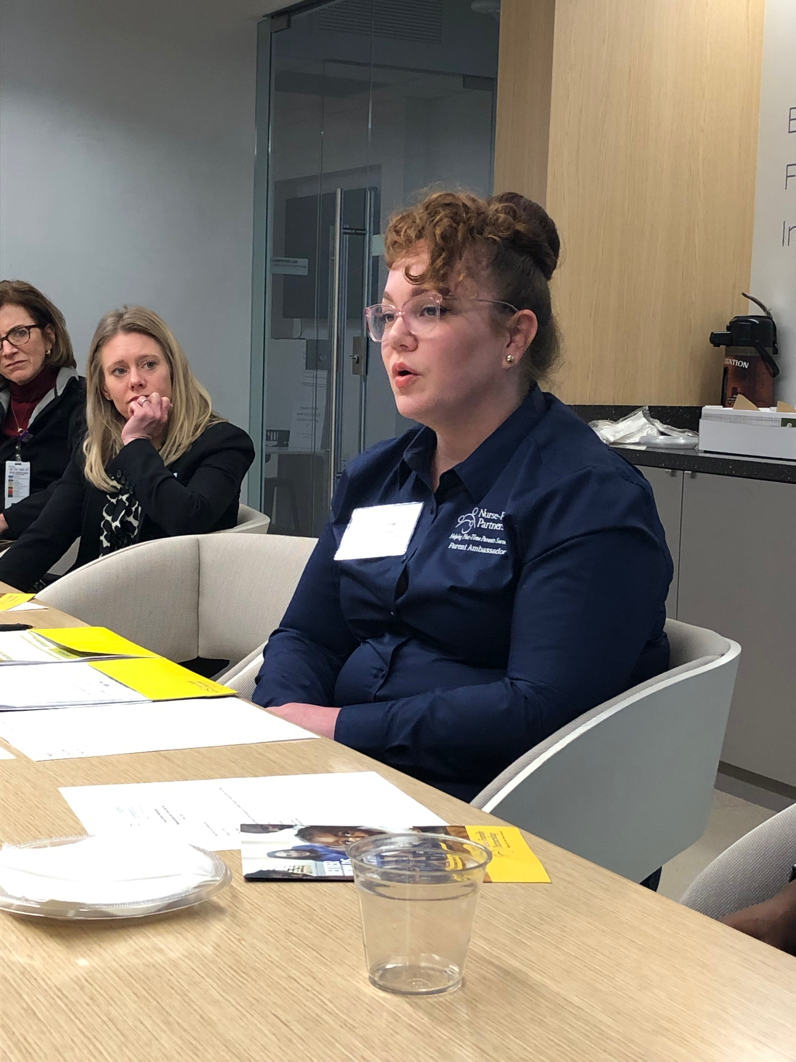
CAB ORIENTATION:
Convene the first meeting and have prepared an orientation package including a short bio of each member, purpose, expectations, any by-laws, etc.
Name tags are helpful, each member introduces themselves.
Have a structured agenda and allow time for everybody to speak.
Having time for board members to socialize can lead to better cohesiveness and board integration.
Use ongoing meetings to provide program updates, consult with your CAB members about the future and to ask members to help with referrals and advocate for your program.
Notes:
So, what does the CAB actually do? What are its functions?

Slide 20
EXAMPLES OF CAB ACTIVITIES
Schedule meetings between local lawmakers and agency representatives to discuss program funding
Plan/host a NFP launch or major milestone events: graduations or anniversaries.
Hold roundtables with community leaders
Write and submit letters to the editor in your local publications that respond to positive stories about NFP or other relevant articles
Write and submit op-eds
Participate in community events, speeches and panels
Staff a booth or exhibit at local health fairs, community celebrations, or business gatherings
Invite local lawmakers on a home visit with a nurse or host them on a visit to the NFP program
Participate in an NFP State Education and Advocacy Day (SEAD) at your State Capitol
What else?
Notes:
Try different actitivies to see which is a success!

Slide 21
WHAT CAB FUNCTIONS EXCITE YOU? WHICH ONES MAKE YOU ANXIOUS?

Slide 22
WHAT TYPE OF CAB DO YOU HAVE?
NFP-Specific
Multi-Functioning Board
Some Multi-Function boards have subcommittees which include an NFP subcommittee.
We recognize that benefits and challenges exist for an NFP specific Board and a Multi-Function Board. Some states also have a Statewide Leadership Board or Advisory Council.
Notes:
There are several common types of CABs. Each has its pros and cons. But for every type of CAB, you can ensure that the necessary elements are in place to support NFP. This may be the time to hand out an example of the state advisory board roles/responsibilities document.

Slide 23
LET’S ROLE PLAY
Choose a discussion leader, scribe and reporter- 30 seconds
Agenda
Who else could we add to our CAB?- 5 minutes
Discussion topic 1- 5 minutes
Discussion topic 2- 5 minutes
Discussion topic 3- 5 minutes
3 strategies to address each
potential challenges?
Notes:
Try different actitivies to see which is a success!

Slide 24
QUESTIONS?
Notes:
Contact the Volunteer engagement team or your Managers of Nursing Practice

